Slide 1
Automating Data Import and Relationship Mapping Using Import Sets & Dot Walking
Team 1 | April 2026

Slide 2
Team Assignments
Team Member | Role & Assignment
Sairam M (Team Lead) | Project oversight, Create records in the Sheet, Conclusion
Karpaga Vinayagam S | Creating Import Table (Staging), Match fields using Mapping Assist
Manuneethi Cholan S | Create Transform Map Configuration
Saravanan R | Transform the Data, Result validation (Testing)
Rada Krishnan S | UI Configuration: Display department to user (Dot-walking)

Slide 3
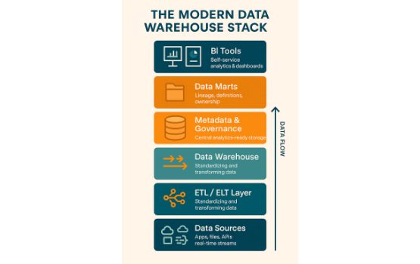
Executive Summary
•
Streamlined onboarding and updates of employee records within ServiceNow via automated data ingestion.
•
Utilized native Import Sets and Transform Maps to transfer external spreadsheet data securely.
•
Integrated directly into the core sys_user table, maintaining critical data architecture.
•
Enhanced IT Service Desk operational efficiency by implementing dot-walking on the Incident form.
•
Significantly reduced manual data entry errors and provided immediate visibility into user context during incidents.

Slide 4






System Context & Infrastructure
System of Record
Manual Bottlenecks
Dot-Walking Power
ServiceNow operates as the centralized system of record for critical enterprise IT operations and management workflows.
Historically, manual user creation and baseline updates have proven to be highly inefficient and prone to human error.
A powerful ServiceNow feature allowing forms to display fields from referenced tables, removing the need for custom scripting.

Slide 5
Key User Pain Points
Administrators: Wasting substantial administrative time manually inputting hundreds of employee records during onboarding cycles.
Service Desk Agents: Experiencing inefficiency caused by constantly switching tabs away from the Incident form to look up an Assigned User's details.
Data Integrity: Compromising database health with duplicate user records created due to a lack of automated coalescing and matching checks.

Slide 6

Understanding Empathy
Before deployment, IT Support Agents and System Administrators faced immense friction. The daily operations were hampered by tedious manual entry and navigation overhead.
By mapping out the thoughts, feelings, and actions of these critical users, we identified that the core frustration was the disconnection between data entry systems and active incident resolution workspaces.

Slide 7
Implementation Workflow
2. Stage & Load
4. UI Config
Utilize System Import Sets to create the staging table u_import_employee.
Apply Form Design to dot-walk user context to Incident workspace.
1. Data Prep
3. Transform Map
Format Google Sheet data and export locally as CSV/XLSX file.
Map identical fields and set email to coalesce targeting sys_user.

Slide 8


Objectives & Prerequisites
Project Objectives
System Prerequisites
1. Establish a repeatable process to ingest CSV/XLSX employee data into the sys_user table.
Access to a ServiceNow Instance with System Administrator (admin) privileges.
2. Ensure no duplicate records are created by establishing a unique identifier (Coalesce).
A properly formatted sample spreadsheet populated with test employee records.
3. Enrich the Incident Management view by surfacing related user data instantly.
Basic understanding of ServiceNow reference fields and table structures.

Slide 9



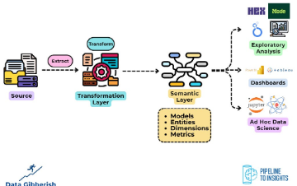

Core Implementation Phases
Data Loading
Transformation
Dot-Walking UI
Securely staging spreadsheet data into a temporary import set table.
Mapping fields and establishing coalesce rules to maintain integrity.
Configuring the Incident form to dynamically pull related profile details.

Slide 10
Final Project Results
Seamless Execution
100%
The Import Set and Transform Map executed seamlessly, proving the integration provides a scalable, reusable pipeline for bulk operations.
Team 1 significantly reduced administrative overhead, eliminated duplicates via coalesce, and greatly enhanced the agent experience by delivering immediate user context on the Incident form.
Records Successfully Ingested

